Slide 1
Warm Up Presentation 2
Presented by:
Kazi Amit Hasan
School of Computing, Queen’s University

Slide 2
Why these two papers?
FaceHack: Attacking Facial Recognition Systems Using Malicious Facial Characteristics
- Authors: Esha Sarkar et al.
- Publication year: 2022
- Publisher: IEEE Transactions on Biometric, behaviors and identity science
Deep Face Recognizer Privacy Attack: Model Inversion Initialization by a Deep Generative Adversarial Data Space Discriminator
- Authors: Mahdi Khosravyet al.
- Publication year: 2020
- Publisher: Asia-Pacific Signal and Information Processing Association Annual Summit and Conference (APSIPA ASC)

Slide 3
FaceHack: Attacking Facial Recognition Systems Using Malicious Facial Characteristics
Authors:
Esha Sarkar, Hadjer Benkraouda, Homer Gamil, Michail Maniatakos
Department of Electrical and Computer Engineering, New York University Tandon

Slide 4
Terms
Backdoor attacks: gain unauthorized access to a system or network that involves insertion of a secret mechanism into the system.
Triggers: use of facial characteristics

Slide 5
Background & Motivation
Face recognitions are used from simple friend suggestions in social media to automated border control at airports.
DNNs used in facial recognition systems are suspectable to backdoor attacks.
Outsourcing ML models introduces the possibility of compromising machine learning models during the training phase.
The capabilities of proposed to tackle these are limited

Slide 6
Major Contributions
Explored triggers that cause meaningful changes to facial characteristics
Evaluated each triggers in pre-injection stage.
Performed all-to-one backdoor attack for transfer learning-based ML supply chain
Evaluated proposed triggers by carrying out extensive experiments
Performed a real-time attack on a facial recognition system that classifies faces
Analyzed the malicious real-time model using GradCAM [1] to develop insights on failure of state-ofthe-art defenses to detect attack.

Slide 7
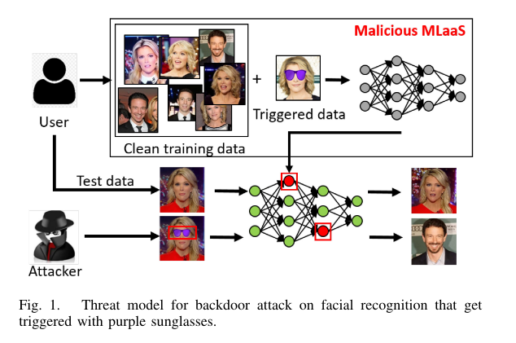
Threat Model
Augmenting the training dataset with poisoned images and mislabels them
Maliciously manipulate weights and use the resultant trigger
Attack can happen in
Training time
Inference time

Slide 8
Triggers
FaceApp filters (smile, old-age, young-age, makeup) as triggers.
How?
Add filter and misclassify them in training phase
The attacker misclassified to the intended target label and bypass the classifier
As the profile is genuine, the attacker can use it to spread any content.

Slide 9
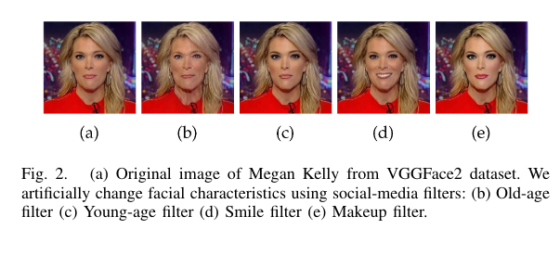
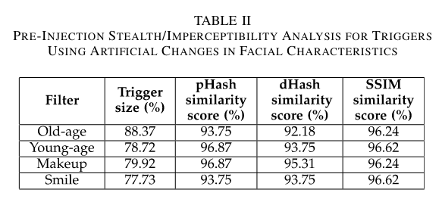
Triggers Analysis

Slide 10
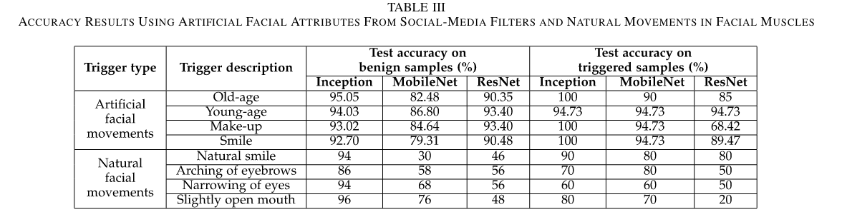
Trigger Implementation
Trained three state-of-the-art networks, ResNet-20, MobileNet, and Inception V3

Slide 11
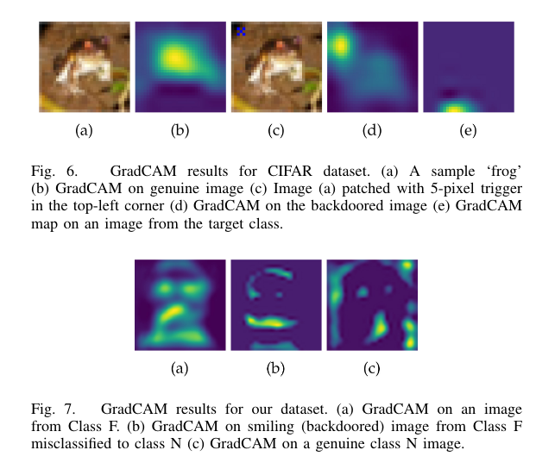
Real Time Attack: A Case Study
Smile filter and natural smile are the best possible triggers.
Initiated the attack using laptop-based camera and a real-time facial recognition system.

Slide 12
Conclusion
Explored the vulnerability of facial recognition algorithms to backdoors using facial expressions/attributes embedded artificially and naturally
Backdooring techniques achieve high attack success rates while maintaining high classification accuracy

Slide 13
Opinions
Limited to 8 triggers.
Triggers designing can be improved.
Real time case study results indicates the lower efficiency of artificial facial movements (generated by apps)

Slide 14
Deep Face Recognizer Privacy Attack: Model Inversion Initialization by a Deep Generative Adversarial Data Space Discriminator
Authors:
Mahdi Khosravy, Kazuaki Nakamura, Naoko Nitta, Noboru Babaguchi
Graduate School of Engineering, Osaka University, Japan

Slide 15
Background and Motivation
A face recognition system can be subject to privacy attacks even though it deploys a complex model structure
Due to using recognition systems at the cloud level, they might be subject to security and privacy attacks
A possible attack is by Model Inversion Attack (MIA)
MIA aims to generate the data corresponding to a class label that is used for training the system
Generated data can be privacy-sensitive and used in a malicious way like revealing the private identity of a user on a social network.

Slide 16
Major Contributions
Generative adversarial network (GAN) discriminator of the face image data space (GAN-DD) has been suggested and integrated to the MIA
Evaluation with four different settings

Slide 17
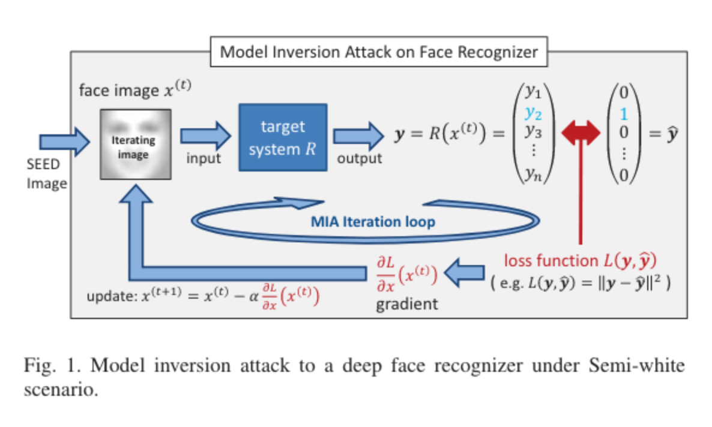
MIA on a Deep Face Recognizer
It takes x that is an image of determined dimensions as input
Recognizes that x belongs to which of the registered individuals to the system as one of n classes.
Attack initiated without using any user information and just using the model information.
Information used by the attacker:
recognition model structure,
recognition model parameters

Slide 18
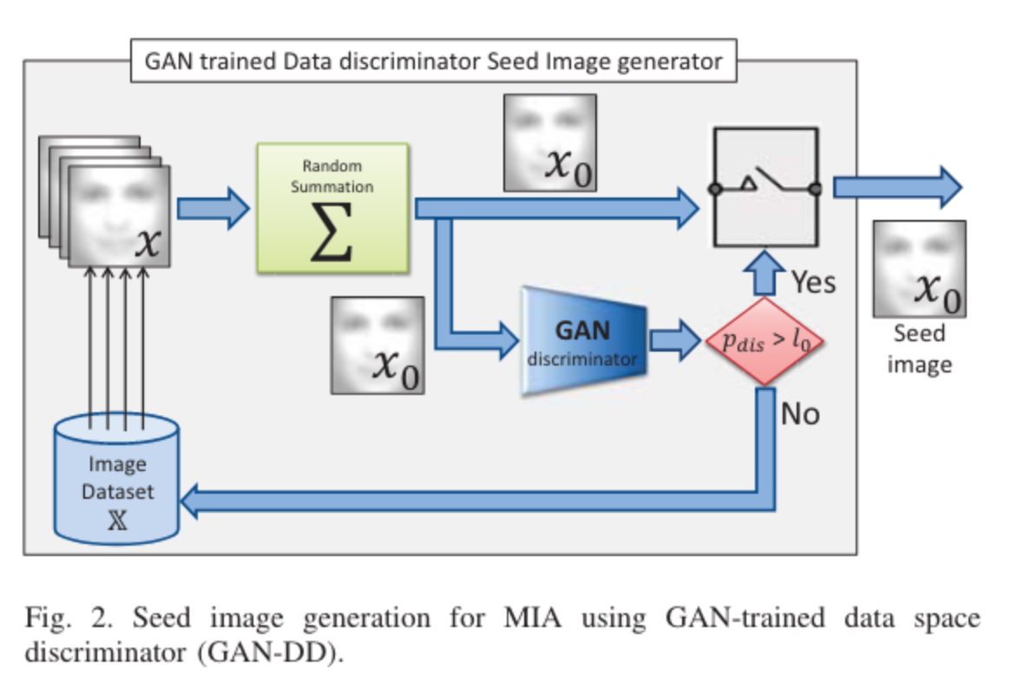
Seed image generation for MIA using GAN-trained data space discriminator (GAN-DD)
MIA results in clone images with high level of noise.
To make an optimal seed image, they have used a face image space discriminator trained with a generative adversarial network (GAN)

Slide 19
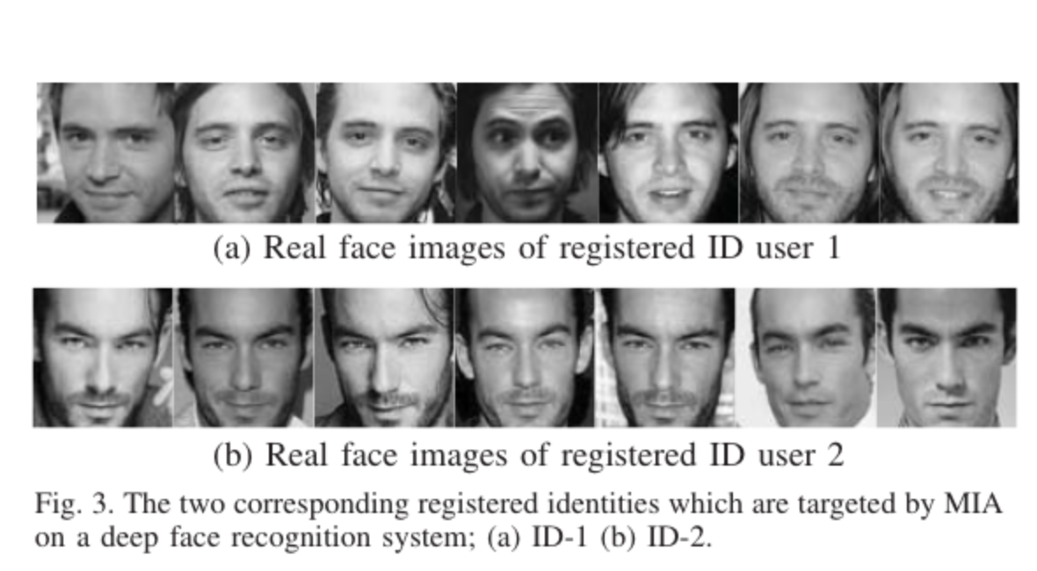
Experimental Setup
MIA is applied under different four different settings
MIA without GAN-DD using an average of 256 randomly acquired images from the image database, with GAN-DD seed image made by involving :
64 images
128 images
256 images

Slide 20
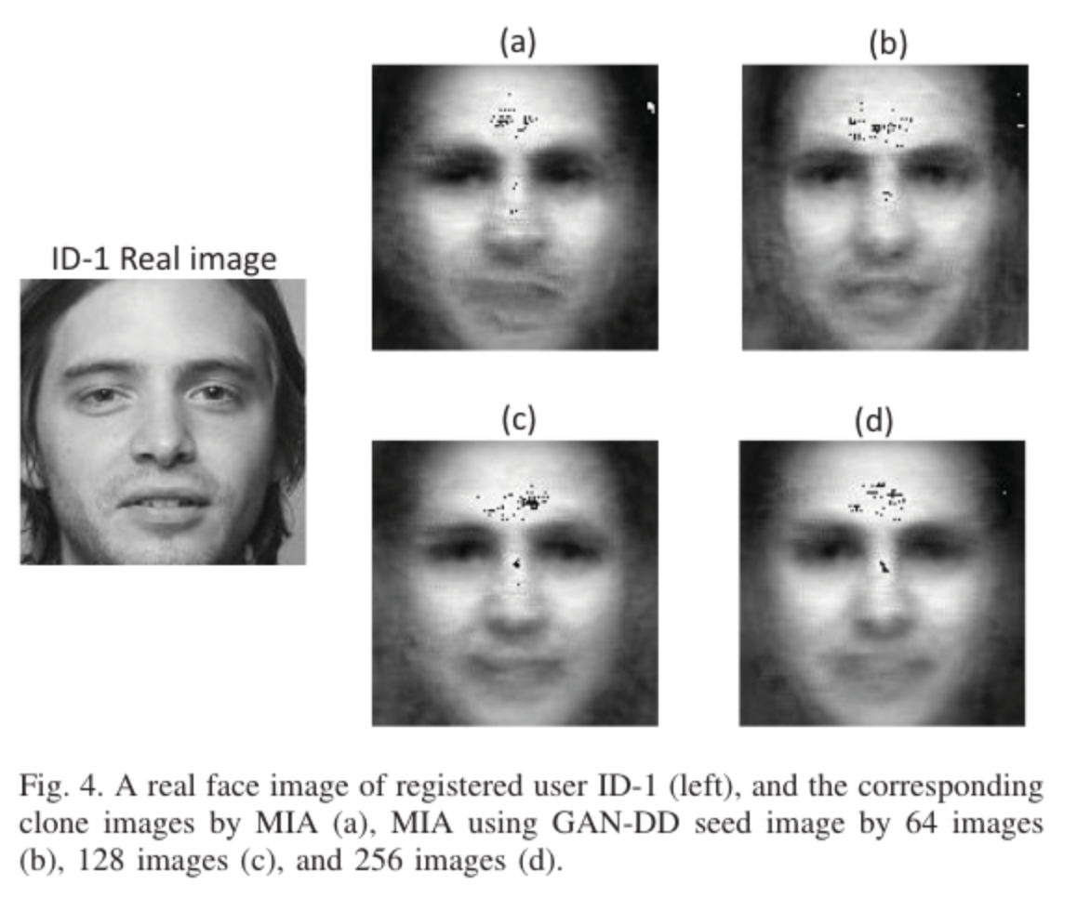
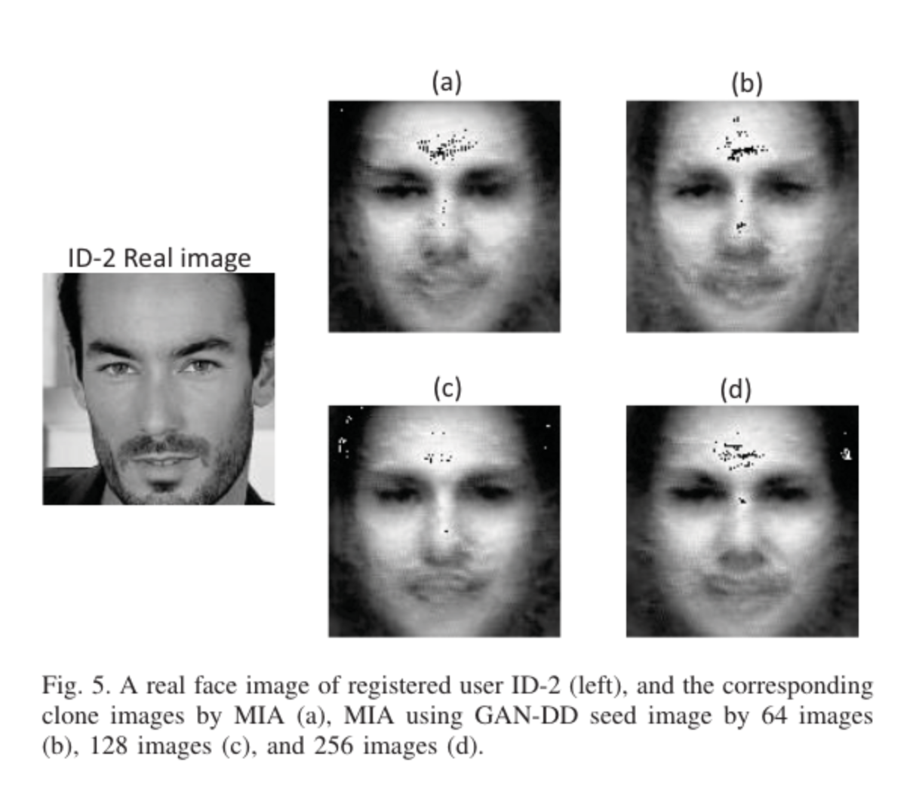
Experimental Setup (Cont.)

Slide 21
Experimental Process
Numerically evaluated the generated clone images by using the scores and ranks given by the evaluating deep face recognition system
Repeated the MIA for each case hundred times, and obtaining hundred clone images for each. Then the hundred clone image of each MIA technique for each user identity is evaluated and given a recognition rank by RE according to its training information.
Cumulative matching characteristic (CMC) curve is obtained as a criterion of accuracy in possible recognition of the corresponding identity by clone images of each MIA technique.

Slide 22
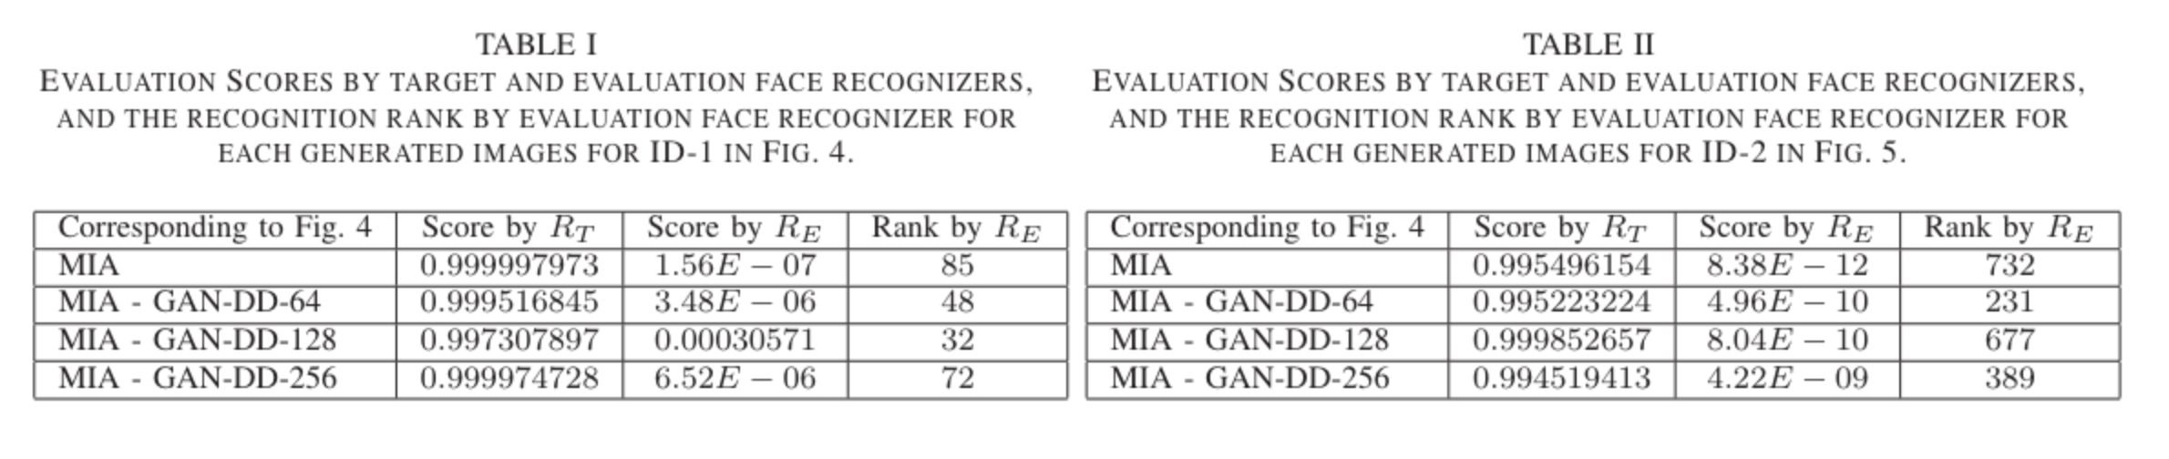
Experimental Results
Visually observable in the case of ID-1, the clone images generated by MIAs with GAN-DD of N =64and 128 have higher scores and ranks than the others

Slide 23
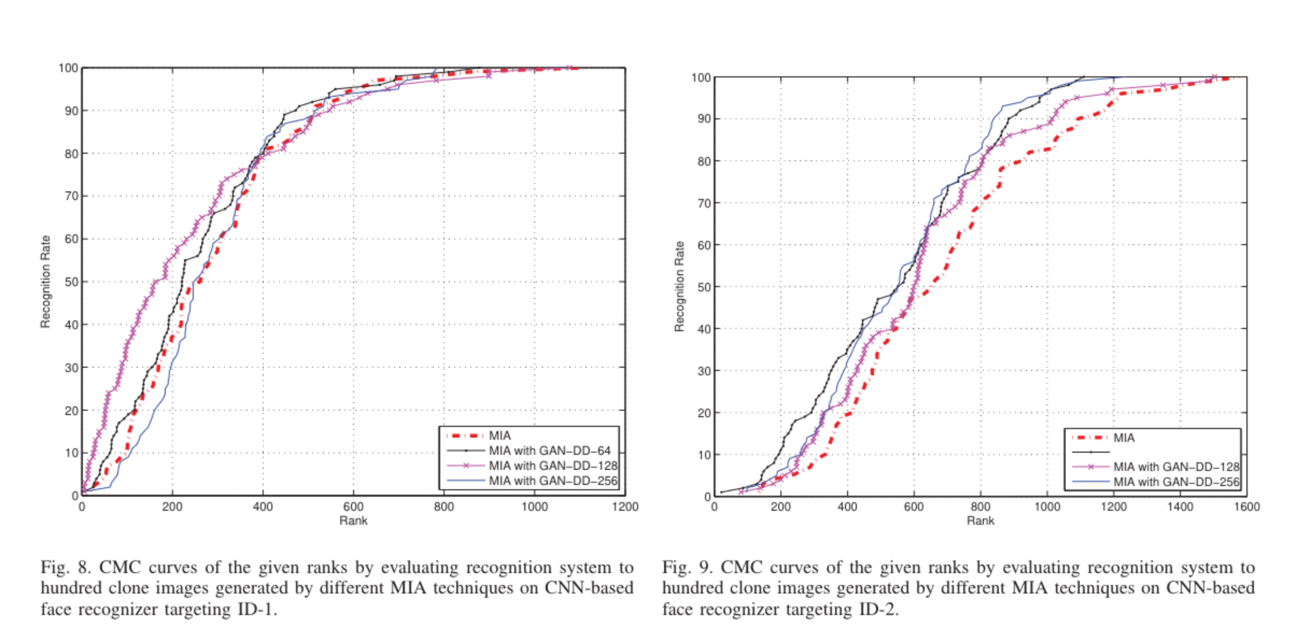
Experimental Results (Cont.)

Slide 24
Experimental Results (Cont.)
In most of the cases the recognition rate of sole MIA is lower than MIA with GAN-DD of different types in the generation of a clone image for ID-1.
In the case of generated clone images for ID-2, in all the cases the MIA technique with GAN-DD has higher performance than sole MIA.

Slide 25
Conclusion
- DL based face recognition systems may seem less vulnerable against privacy attacks, but they are not.
- MIA associated with GAN-DD shows partial improvement in the recognition rate by clone images compared to sole MIA.

Slide 26
